Slide 1
Transformer

Slide 2
Outline
Introduction
Similarity Score
Attention Mechanism

Slide 3
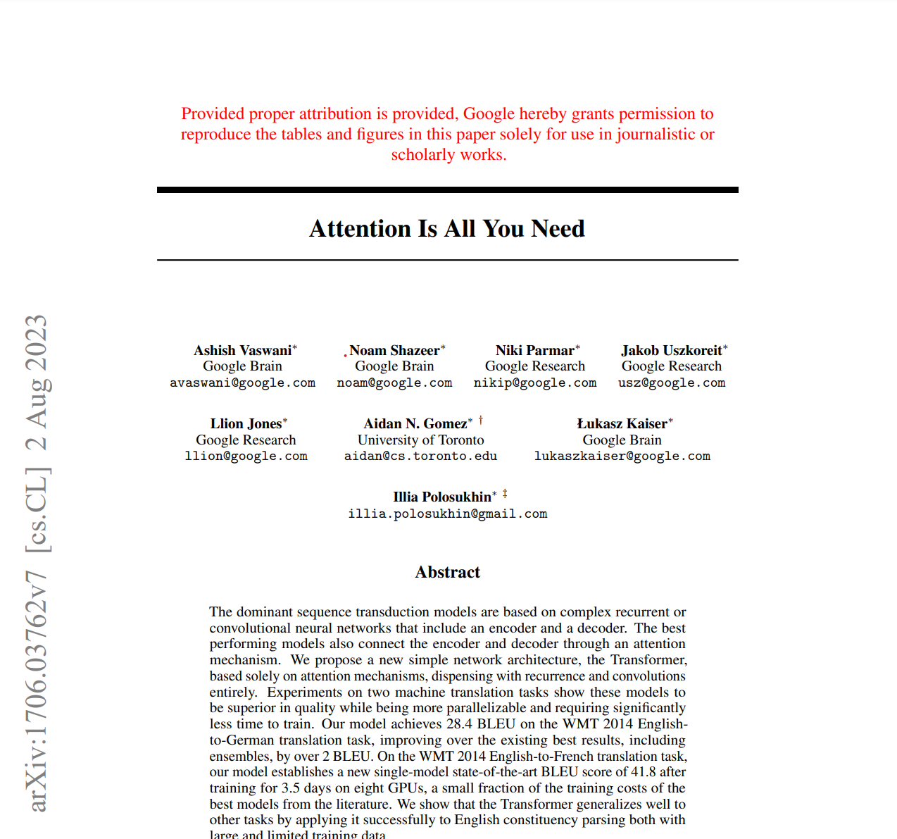
Transformer
Transformer is a model introduced by Vaswani et.al in the paper “Attention Is All You Need”.
Transformers are the de-facto standard models not only in sequence to sequence tasks but also for language modeling

Slide 4
Transformer
In contrast to encoder-decoder models where processing was done with recurrence or convolutions, Transformer operates using only attention.

Slide 5
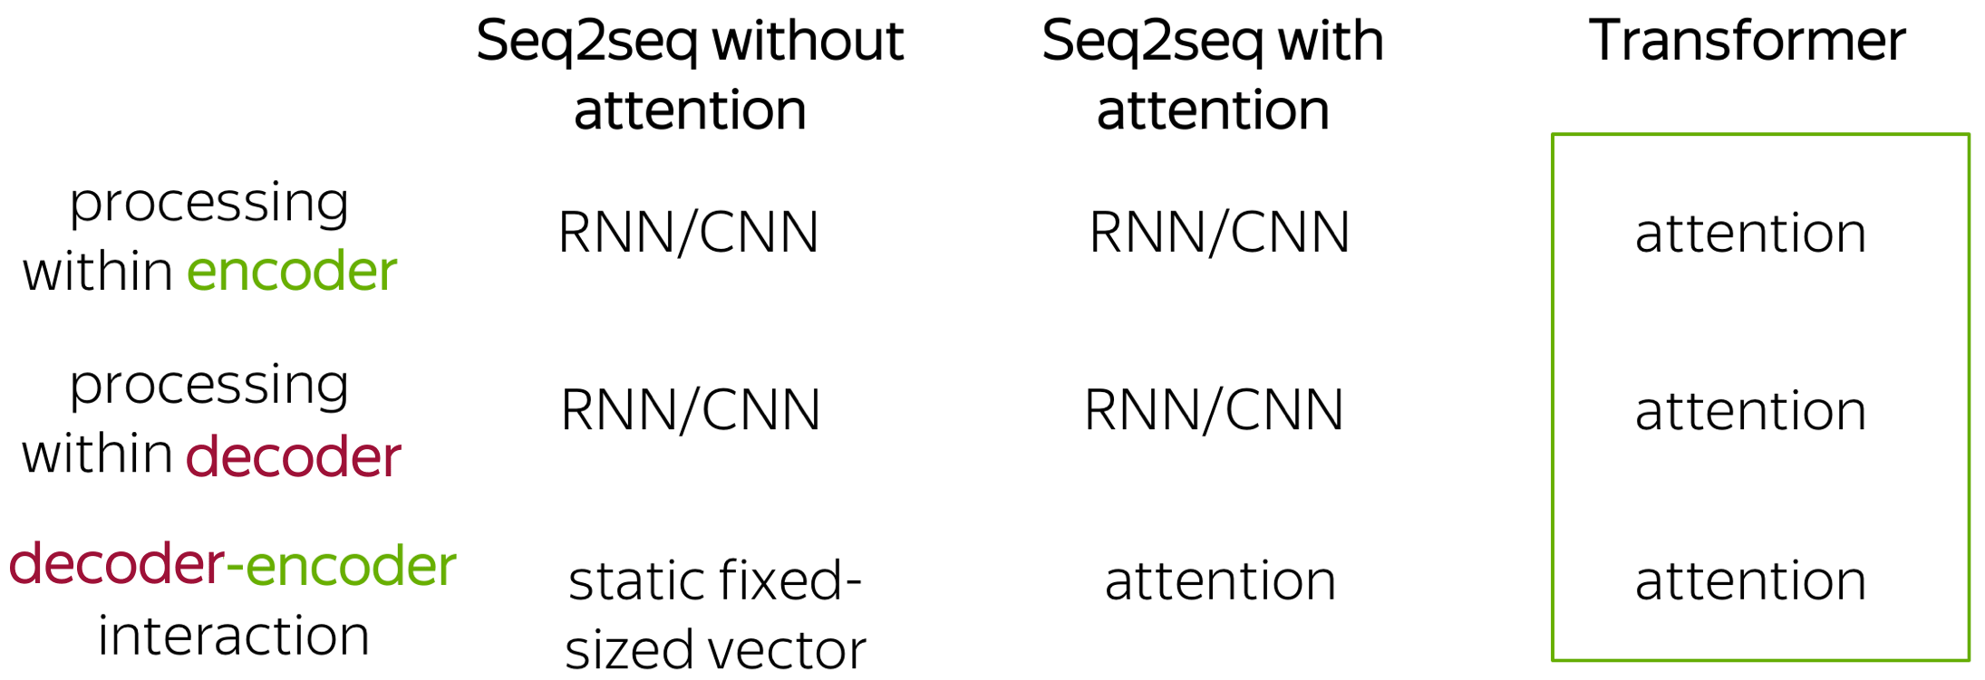

Slide 8
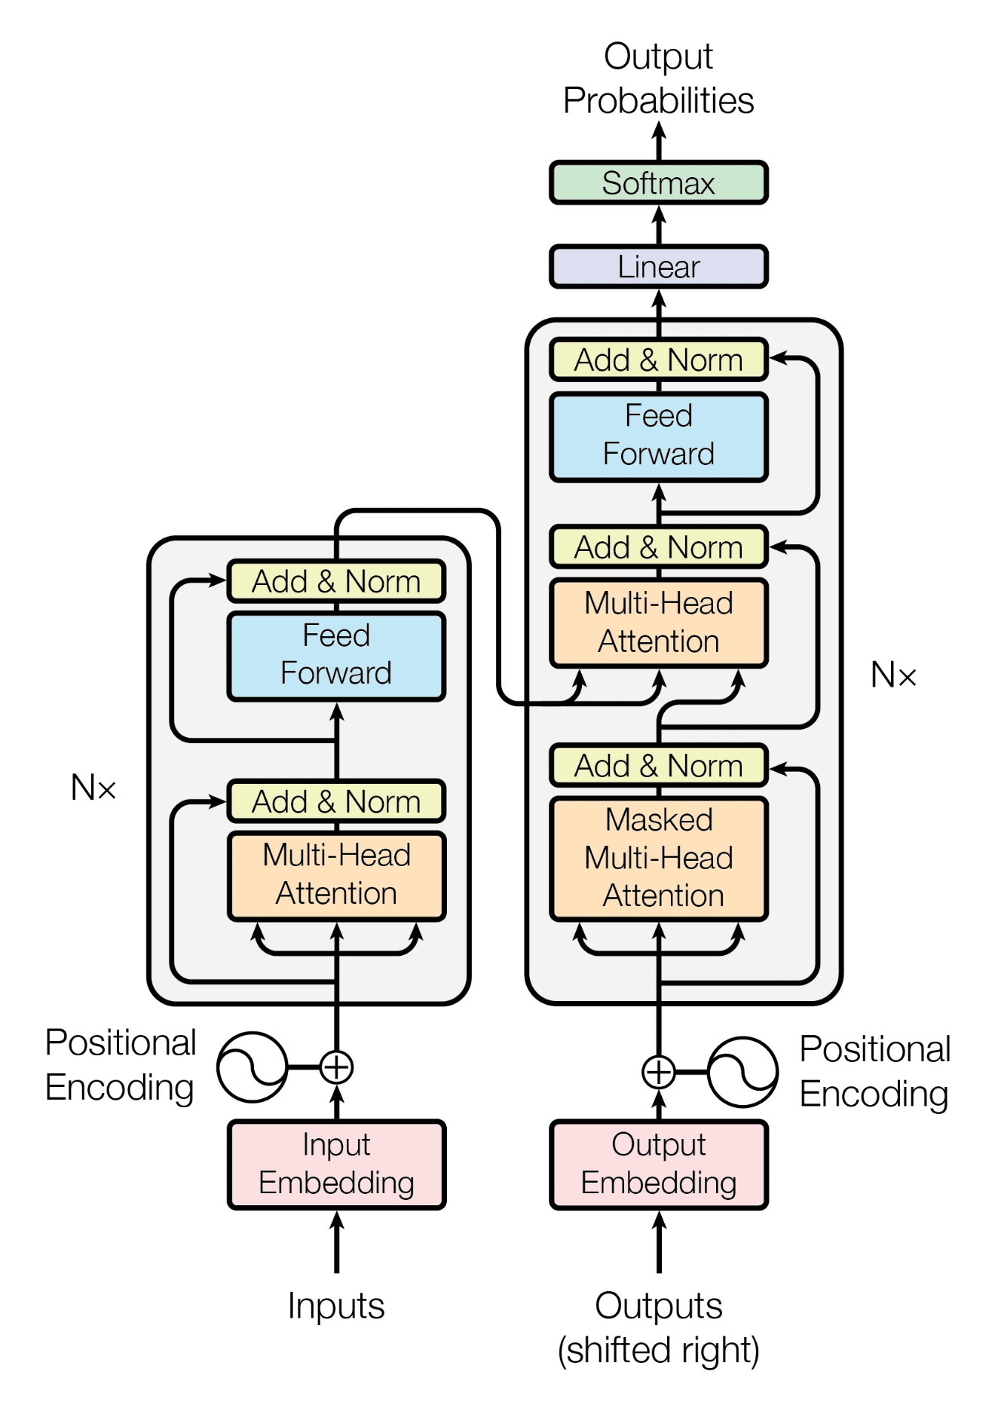

Slide 9
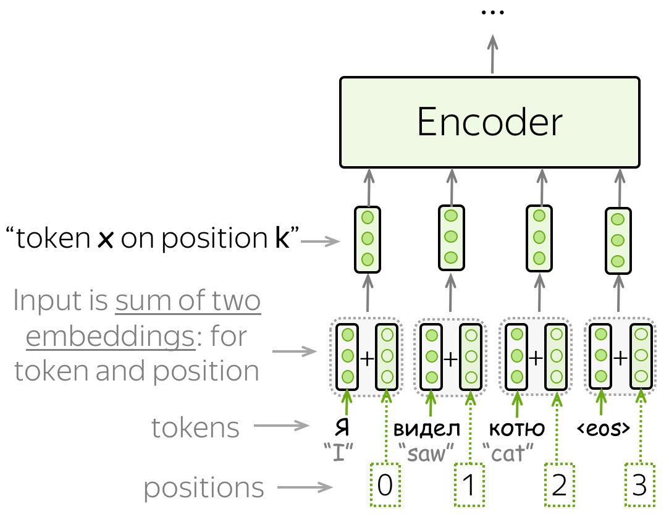
Since a Transformer does not contain recurrence , it does not know the order of input tokens.
Therefore, we have to let the model know the positions of the tokens explicitly.
For this, we have two sets of embeddings: for tokens and for positions. The input representation of a token is the sum of two embeddings: token and positional.

Slide 10
Self-attention is one of the key components of the model.
The difference between attention and self-attention is that self-attention operates between representations of the same nature: e.g., all encoder states in some layer.

Slide 11
Self-attention is the part of the model where tokens interact with each other.
Each token "looks" at other tokens in the sentence with an attention mechanism, gathers context, and updates the previous representation of "self".

Slide 12
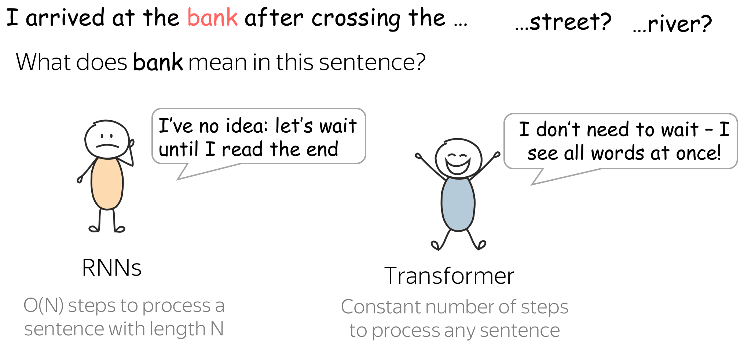

Slide 16
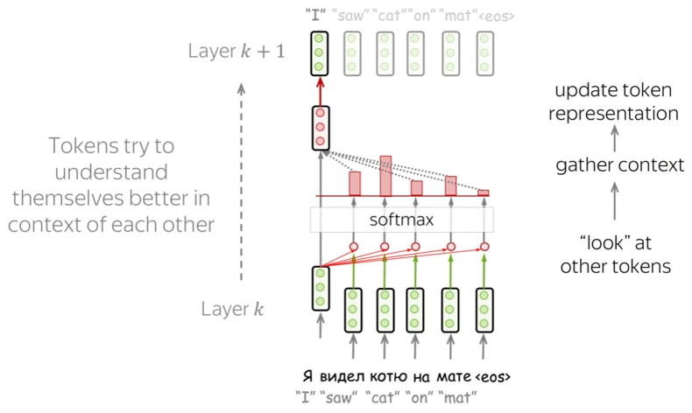

Slide 17
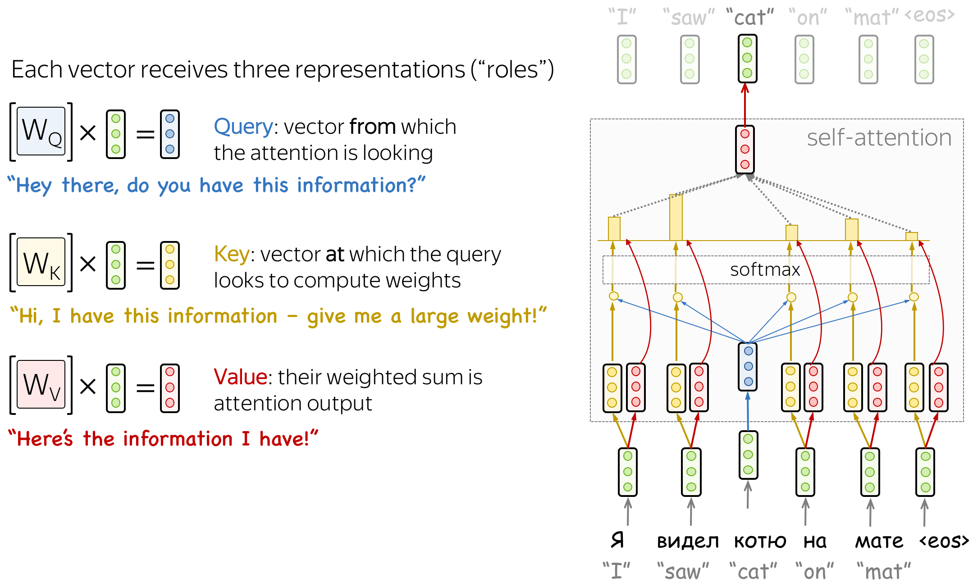

Slide 18
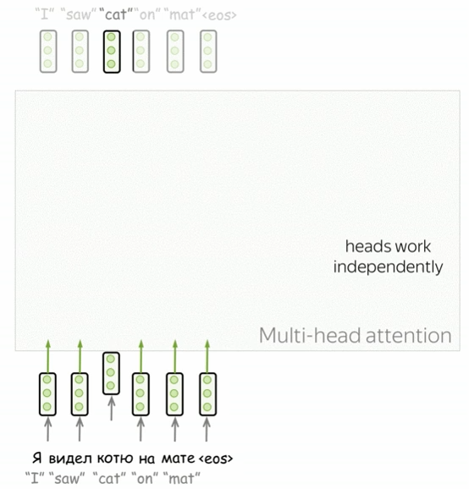
Self-attention is the part of the model where tokens interact with each other.
Each token "looks" at other tokens in the sentence with an attention mechanism, gathers context, and updates the previous representation of "self".

Slide 19
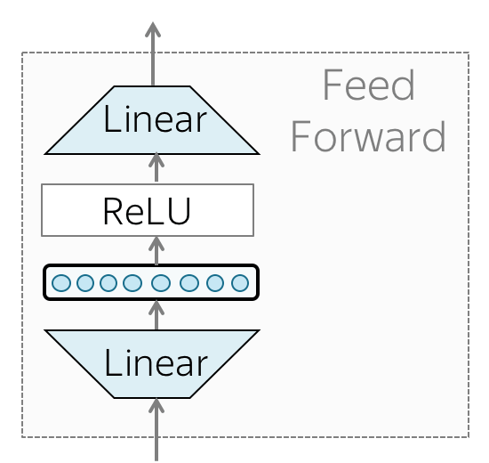
In addition to attention, each layer has a feed-forward network block: two linear layers with ReLU non-linearity between them
After looking at other tokens via an attention mechanism, a model uses an FFN block to process this new information (attention - "look at other tokens and gather information", FFN - "take a moment to think and process this information").

Slide 20
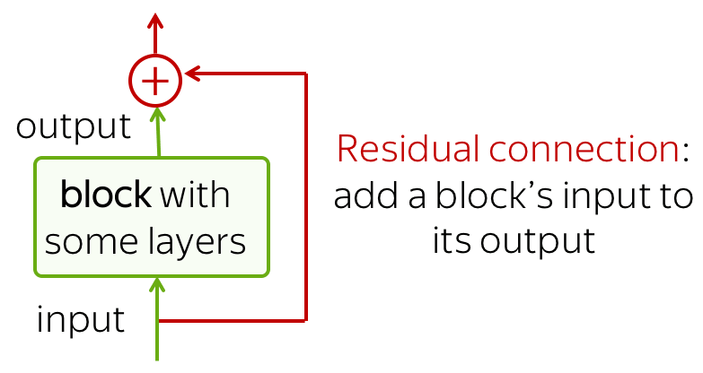
Residual connections ease the gradient flow through a network and allow stacking a lot of layers.
In the Transformer, residual connections are used after each attention and FFN block. On the illustration above, residuals are shown as arrows coming around a block to the yellow "Add & Norm" layer. In the "Add & Norm" part, the "Add" part stands for the residual connection.

Slide 21
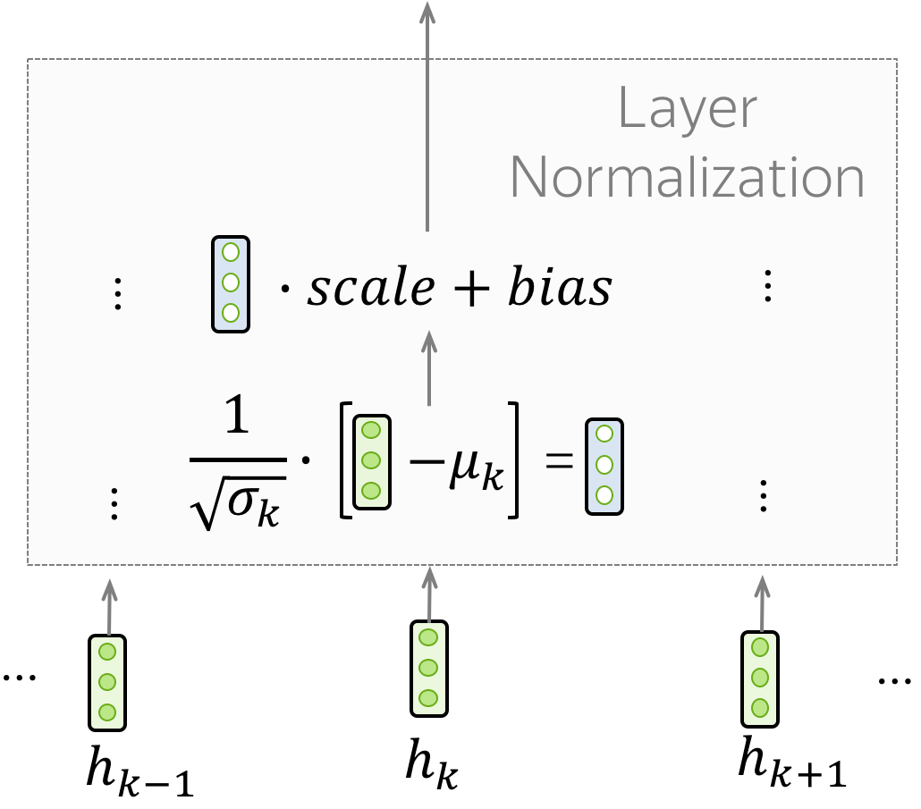
The "Norm" part in the "Add & Norm" layer denotes Layer Normalization.
It independently normalizes vector representation of each example in batch - this is done to control "flow" to the next layer. Layer normalization improves convergence stability and sometimes even quality.

Slide 22
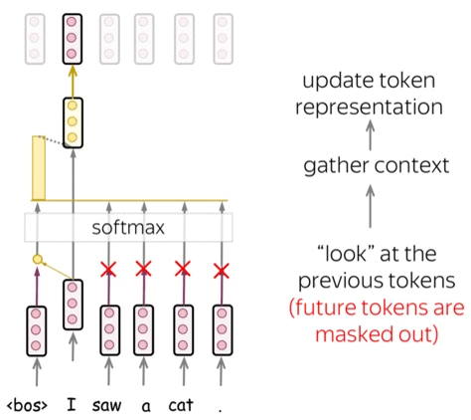

Slide 23
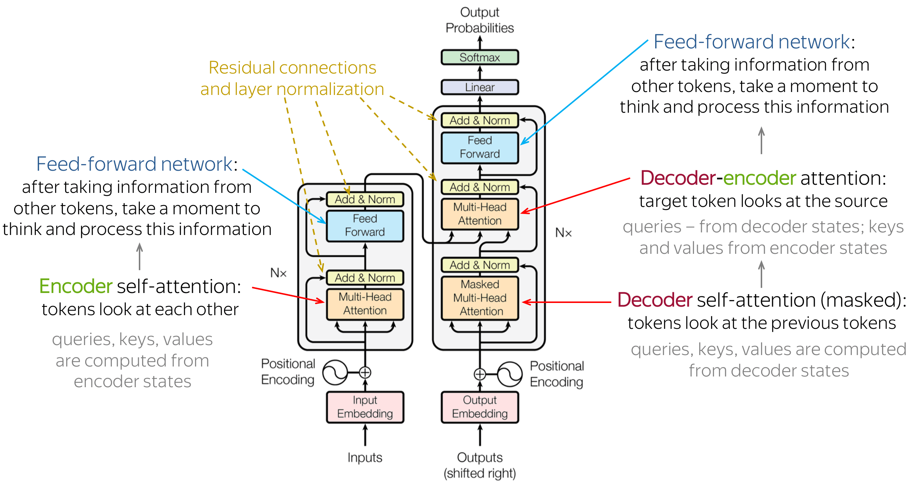

Slide 24
References
https://arxiv.org/pdf/1706.03762
https://lena-voita.github.io/nlp_course/seq2seq_and_attention.html

